Slide 1
Sign-Language Recognition Using Machine Learning With Accuracy Analysis
G kiran kumar (318126510139)
E V M Prateek (318126510138)
Azharuddin (318126510174)
Guided By
Dr. V Usha Bala
REVIEW 2

Slide 2

A Quick Recap…
There is a problem when mute people try to communicate with people who do not know sign language. We suggest a solution to this problem using ML based translator that can identify Indian sign language and translate to English.
Problem segmentation & Workflow
System Architecture & Module division
Initial Results

Slide 3
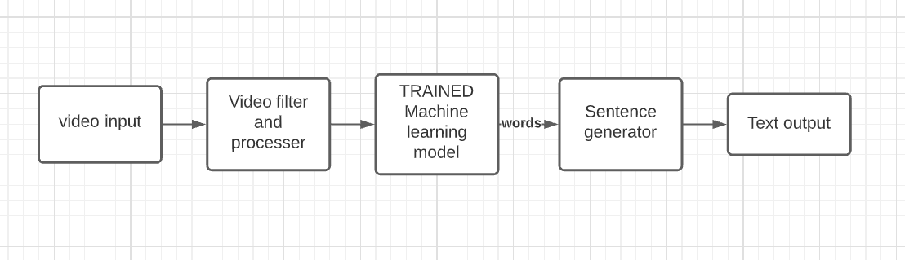

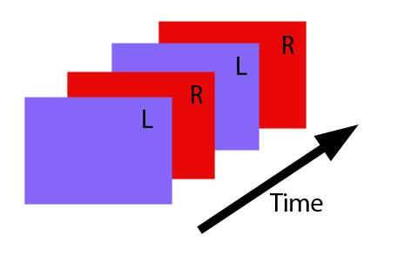


System Architecture
I am Kiran

Slide 4
Workflow
Phase 1
Alphabet recognition
Implementing object detection for accuracy analysis, Algorithm selection (image dataset)
Phase 2
Gesture recognition
Including facial gestures and training using video data (10 words)
Training complete model (100 words)Implementing Natural language processing algorithm for sentence generation
Phase 3
Sign recognition

Slide 5
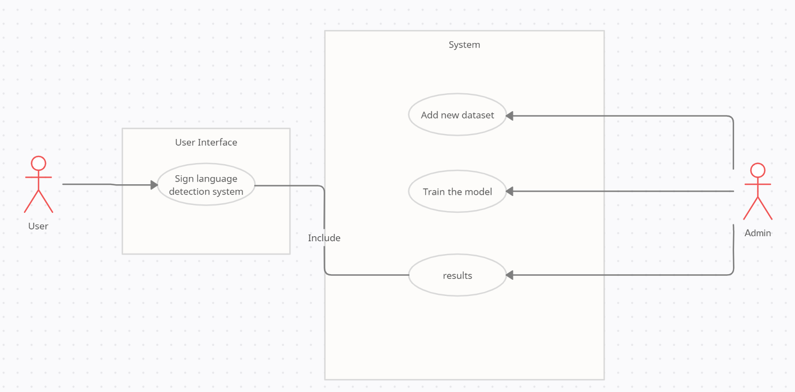
UML (use case)
I am Kiran

Slide 6
Module division
Face gesture
Detection
Model
VIDEO PROCESSOR
Extracts face, hand
Text output
Gui and Speaker output
INPUT
Video or
Image
I am Kiran
Hand gesture recognition Model

Slide 7
Code analysis
Training phase
Recognition phase
Input type
Image
Video

Slide 8
Code Analysis For phase - 1
Training phase (IMAGE dataset for signs/Alphabets)
Train the CNN algorithm using Images of signs in Indian Sign language
TRAINED MODEL
IMAGES
CNN MODEL

Slide 9
Recognition Phase
Use the trained model to recognised Alphabets and Digits.
Recognise the gesture from the image.
TRAINED CNN MODEL
RECOGNISED GESTURES
IMAGES

Slide 10
Code Analysis For phase - 2
Training phase (VIDEO dataset for gestures/words)
Train the LSTM algorithm using Images of signs in Indian Sign language
TRAINED MODEL
VIDEOS
LSTM MODEL

Slide 11
Recognition Phase
Use the trained model to recognise gesture in the video
Recognise the gesture from the video frame
TRAINED LSTM MODEL
RECOGNISED GESTURES
LIVE VIDEO

Slide 12
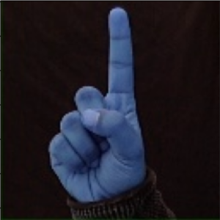
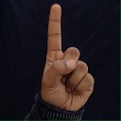
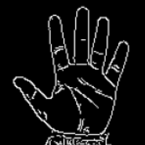
Dataset Acquisition and Modifications
Dataset is taken from Kaggle (Link)
Transformed dataset to account both right hand and left hand users.

Slide 13


Dataset Acquisition and Modifications cntd.
Using mediapipe to convert video data into coordinates for training LSTM model
We can change the duration , and also number of instances of each data element
LSTM MODEL
Numpy files

Slide 14

Technologies used
Tensorflow
To train the CNN model using the inbuilt Modules in tensorflow
Tkinter
To make a stand-alone applications with various elements available in Tkinter
Pickle
To convert Images to Matrices and saving them for training and testing on future
Mediapipe
To get anchor points of face and hands to train the LSTM with the generated files

Slide 15
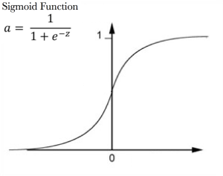
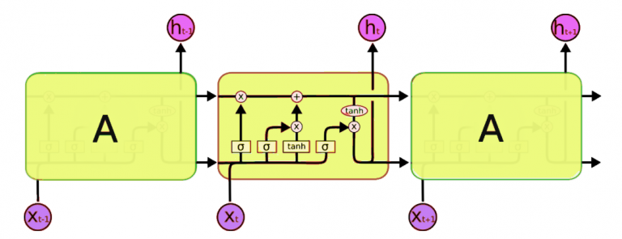
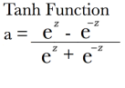
LSTM
H - output
X - input
x - forget gate
Sig - sigmoid function
Tanh - tanh function

Slide 16
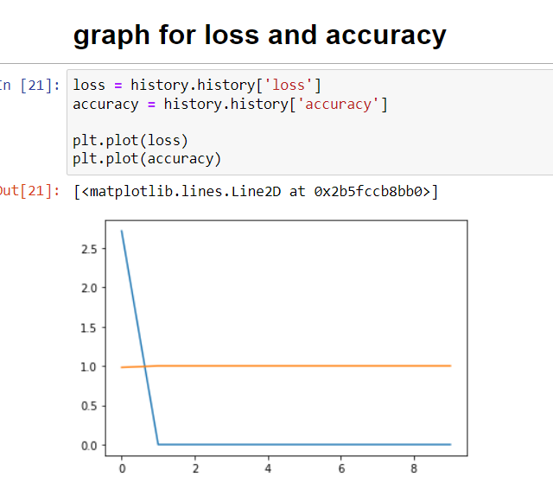
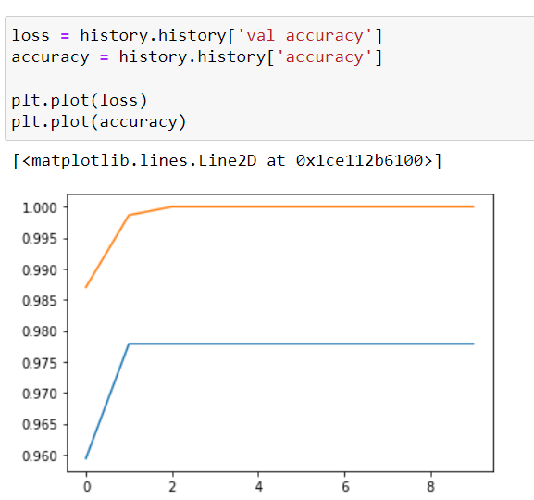
Accuracy Graphs (CNN-Dense)

Slide 17
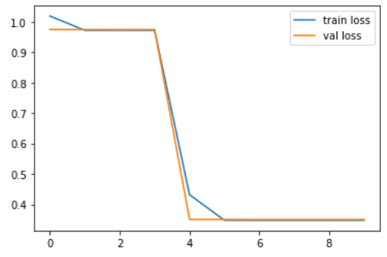
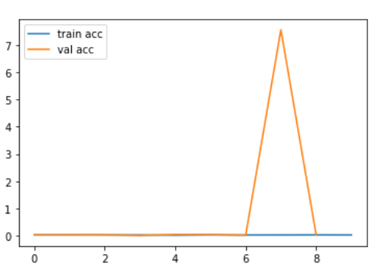
Accuracy Graphs (CNN-SVM)

Slide 18
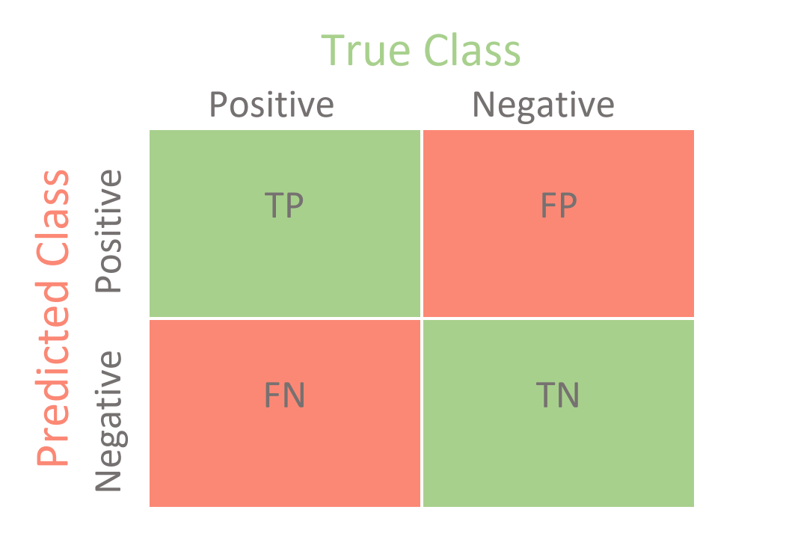
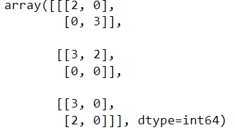
Confusion matrix
Accuracy : (TP+TN)/total

Slide 19

Existing problem and our solutions to the problem
Existing problem
We’ve found that the hands with black background are accurately recognised, where as hands with colored background are not being recognised.
Suggested solution
The Solution we came up with is to find outline of the hand and to differentiate the hand in the image from the background.

Slide 20
Moving Forward
including More gestures.
Adding Sentence generation
Integrating modules to a single executable.

Slide 21
References
Implementation references
Tensorflow Reference videos
Tkinter for GUI videos
Pickle videos
Tensorflow Documentation
Tkinter Documentation
Pickle Documentation
Media pipe Documentation

Slide 22
References
Research Papers
Accuracy analysis paper
Project Idea paper
Implementation inspiration paper
https://drive.google.com/file/d/1gOO20k-eyH7GtNm1PfjSQ5wXD9w6_5kD/view?usp=sharing
https://drive.google.com/file/d/1EIQ-XWRxuzSEGoclHD1yBYRLzSeUpB18/view?usp=sharing
https://drive.google.com/file/d/14sdlBv7UYz2qbprNgnMNL1QyvZBZFyXU/view?usp=sharing

Slide 23
References
Documentation , words selected
project details
Project documentation
Official Sign translation and dictionary
https://indiansignlanguage.org/
http://www.islrtc.nic.in/

Slide 24
Thank you for your time.

